Slide 1

Data Engineering Class 2.1 Grouping data
Carlos De Oliveira
(Carlos.DeOliveira@NYU.edu)
Fall 2023

Slide 2




Real-Time Data (RTD)
RTD
Clusters
recalculated
time-to-time
(monthly, weekly, etc.)
DB
Cluster 1
Cluster 2
Historical time-series
Cluster 3
…
Statistics for each cluster
from each time-series:
average return,
standard deviation (risk),
duration,
etc.
Which cluster?
Buy
Cluster K
Do-nothing
Filtering
and decision
Decision
Sell
Execution
Including Take-profit, Stop-loss, etc.

Slide 3
Similarity
distance:
a to b = b to a
tranangle
possitive
Euclidian space
Non-Euclidian Space
https://youtu.be/S8N4iTR-tM0?si=GOH4P8uqWq2SaQyD

Slide 4
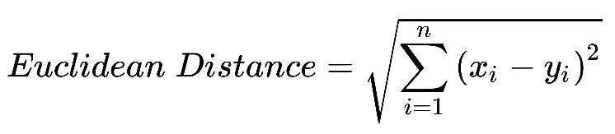

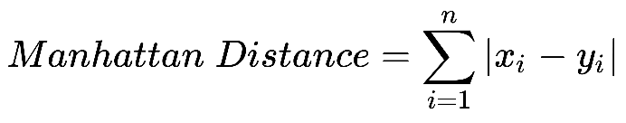
Euclidian Space

Slide 5

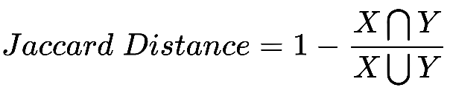
Non-Euclidian Space

Slide 6
Termination
With a known number of groupings
Because the definition of the problem
Example: grouping audio samples from a recorded conversation where you know precisely five people were talking.
K-means algorithm
If the correct k value is known, then the termination condition focuses on convergence
Without a known number of groupings
Silhouette score

Slide 7
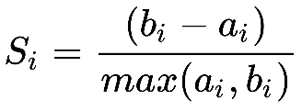
Silhouette score
For a point i, if a is the average distance to all other points within its own cluster, and b is average distance to all points in nearest neighboring cluster, the silhouette coefficient is given by the following formula:
Silhouette score = mean(S_{n}) → between [-1,1] → the larger, the better cluster quality

Slide 8


Introduction to regression

Slide 9
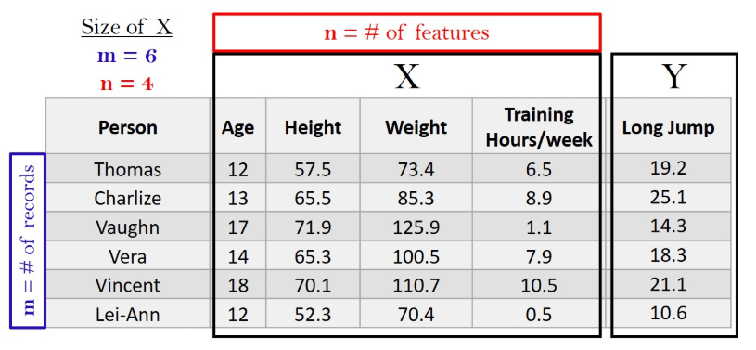
Prediction algorithm as a minimization problem
We define “bad behavior” as missed predictions (loss)
Then, we define the problem as: minimize “bad behavior”
Example:

Slide 10

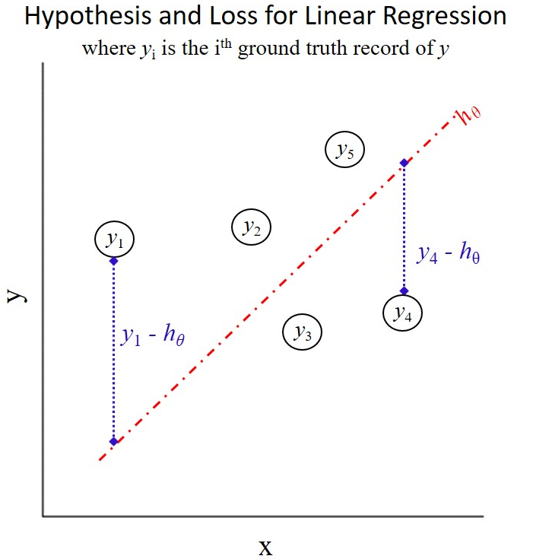
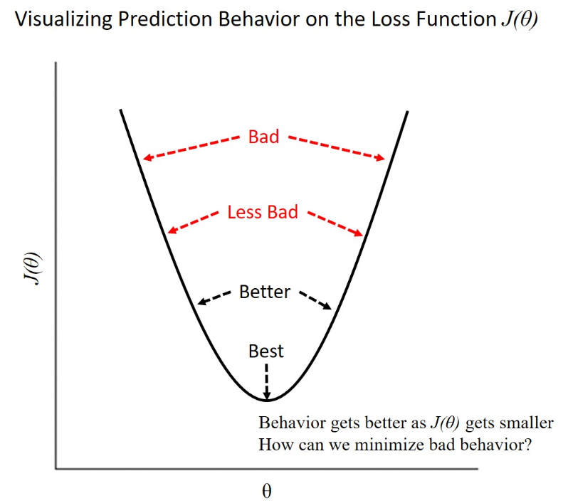
Mathematical machinery
Loss function
Gradient descent

Slide 11
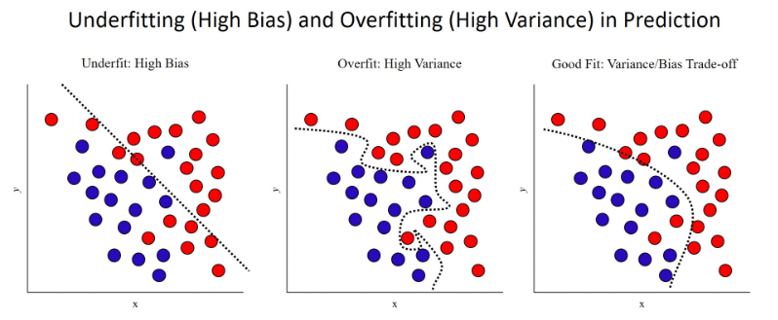
Fitting Quality Regimes
Part of the model tuning process is to measure not only prediction accuracy on the training dataset, but also to measure it on a held-out test set

Slide 12


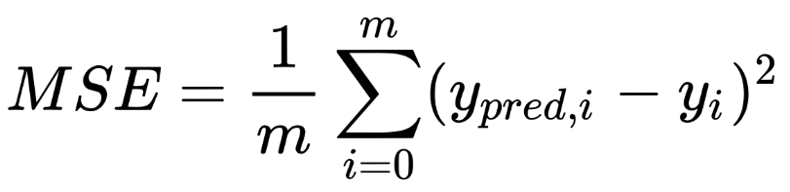
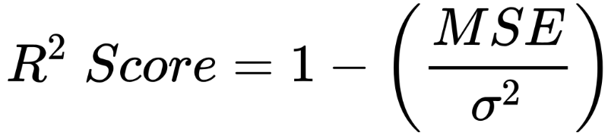
Regression
Metrics of regression model prediction
See example

Slide 13
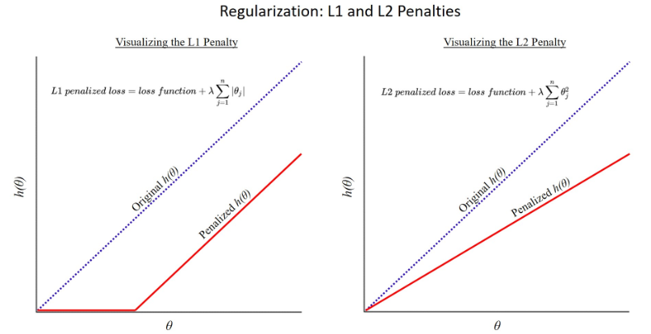
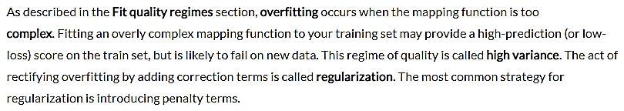
Regularization with penalized regression
See Lasso Regression example

Slide 14
Classification
Classification models map input data to an output prediction of a categorical class label, as opposed to regression models that predict numerical values. The distinction is most easily conveyed through examples:
Classification models can assign labels such as true/false, low/medium/high risk, or which animal species.
Regression models can predict output such as housing prices, long jump distances, or number of home runs hit.

Slide 15
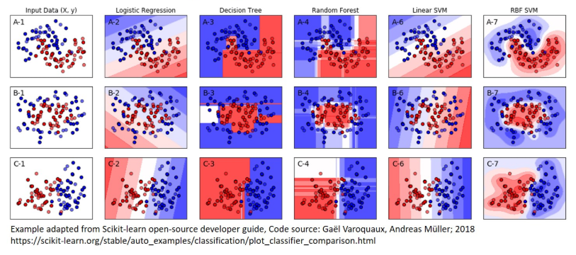
Comparing Classification Methods
linear / nonlinear
See PyCaret

Slide 16
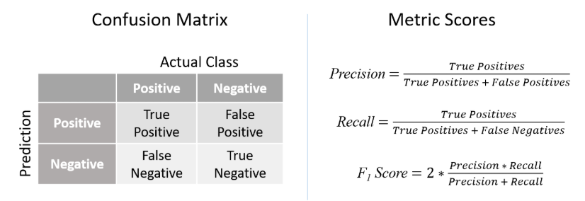
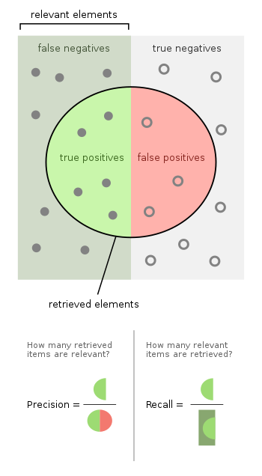
Metrics of Classification

Slide 17
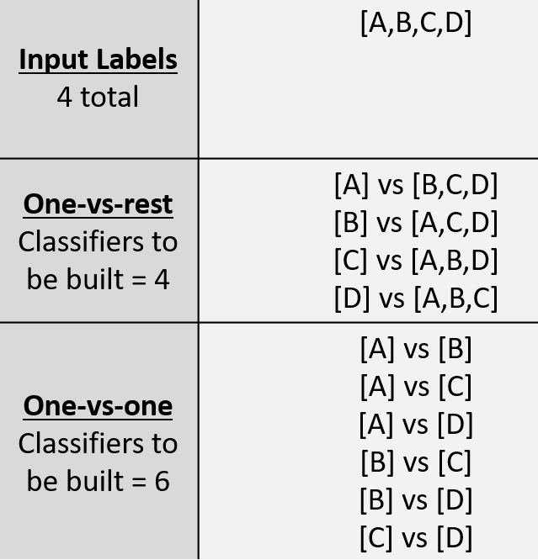
Multi-class classification

Slide 18
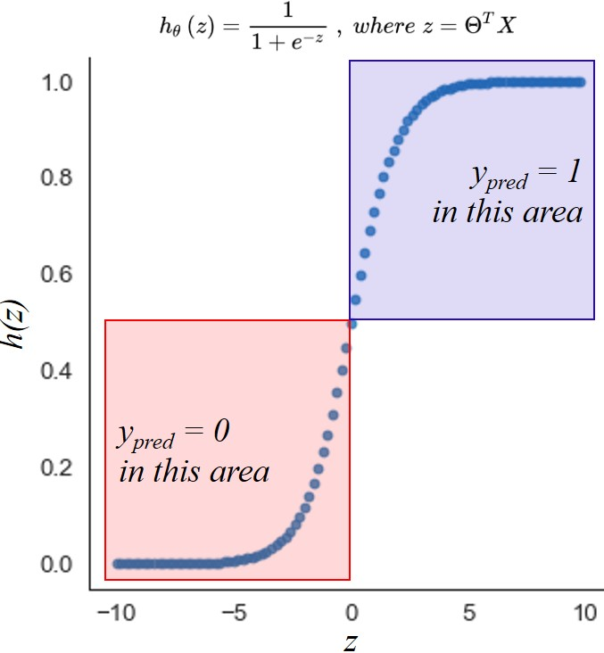
Logistic Regression
See example

Slide 19
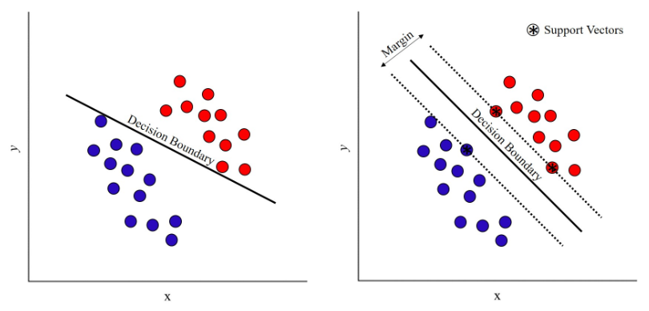
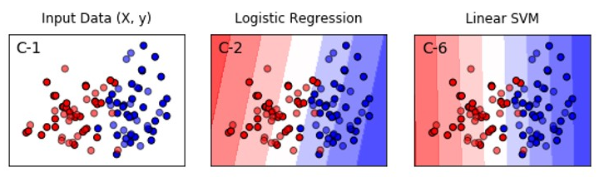
Support Vector Machine (SVM)
Expands on the concept behind the log regression to create a classifier targeted directly at finding the maximum margin between classes

